Slide 1
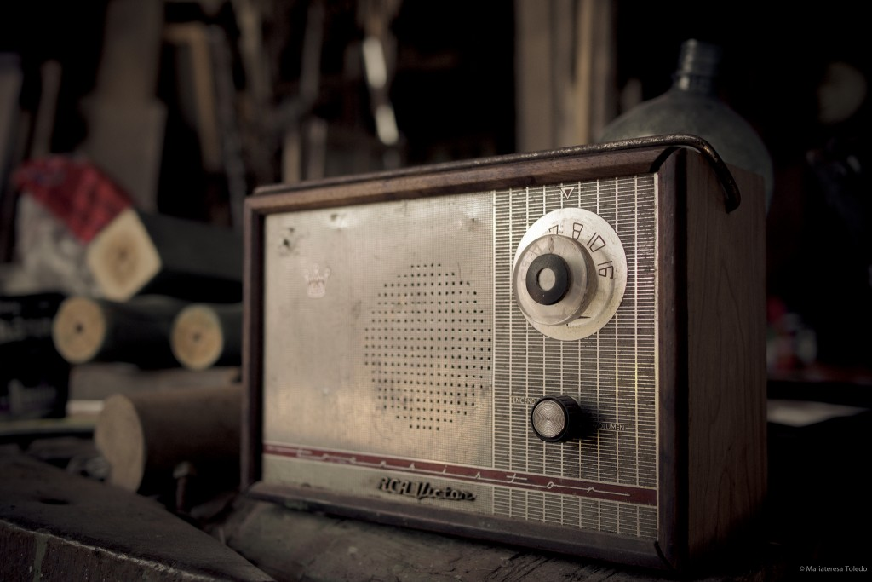
EU-MIND
MASS
MEDIA

Slide 2
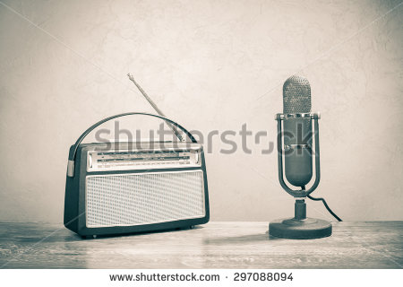

Slide 3
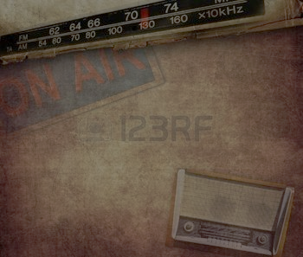
THE PRESENTATION TO COMPARE OLD WAYS OF COMMUNICATION WITH THE LATEST MODES OF COMMUNICATION IS ILLUSTRATED IN A STORY FORM.
THRE STORY INVOLVES CONVERSATION BETWEEN MY DADDY’S IPOD (LATEST MODE OF COMMUNICATION) AND GRANDPA’S RADIO(OLD WAY OF COMMUNICATION.

Slide 4
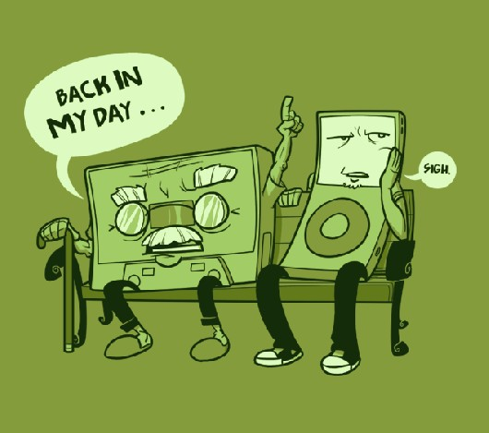
ONE LAZY SUNDAY AFTERNOON, WHILE SITTING AT MY TABLE, I SAW SOMETHING LIKE THIS… MY GRANPAS RADIO AND MY DADS IPOD WHERE HAVING A REALLY SEROIUS TALK….CAN U IMAGINE!!!!.....IT WAS SOMETHING LIKE THIS……..

Slide 5
DADDY IPOD: WHAT WAS THE MASS MEDIA IN YOUR TIMES LIKE ?
GRANDPA RADIO:” THOSE TIMES WHERE DIFFERENT KIDDO, THE OLD SIMPLE WAYS OF COMMUNICATING , ALMOST EVERY THING WAS PRINTED - NEWSPAPER, GRAMOPHONE, LETTER, TELEGRAPH, MAGAZINES……
DADDY IPOD:”BUT DAD I FEEL, THE NEW WAYS OF MASS MEDIA ARE MUCH FASTER AND CONVIENIENT..INTERNET, IPODS,MOBILE PHONES, LAPTOP, PCUS…
IT IS MUCH BETTER…

Slide 6
GRANDPA RADIO: BUT WHY DO YOU THINK THE NEW WAY OF MASS MEDIA IS BETTER?
DADDY IPOD: BECAUSE THE NEW GENERATIONS COMMUNICATING WAY IS MUCH SPEEDY …EFFIECIENT….INNOVATIVE . WITH THE INFASHION ….ONLINE MARKETING AND JOB OFFERS IN NEWSPAPERS.. AND HEY I LIKE THE TOUCH SCREEN OF MY IPOD!!!…..

Slide 7
GRANDPA RADIO: SON BUT WHY DO YOU CHOOSE NEWWAYS OF MEDIA IN PLACE OF THE OLD ONE?
OF COURSE IT PROVIDES…QUICK INFORMATION, AMPLE CHOICES , WIDER HORIZON OF KNOWLEDGE……COMMUNICATION IS EASIER AND FASTER , SHOWCASING TALENTS ,PLATFORMS FOR VISUAL LEARNING, UPDATED TECHNOLOGY, AND SAVES TIME ,BUT IT ALSO HAS SOME DISADVANTAGES……..

Slide 8
GRANDPA RADIO: MASS MEDIA IS A DEIVIATION/DISTRACTION FOR CHILDREN THESE DAYS.IT AFFECTS CHILD GROWTH AND ENCOURAGES EARLY MATURATION.IT IS A WASTE OF TIME AND MONEY.A CHILD WHO IS ADDICTED TO MASS MEDIA IS LETHARGIC IN NATURE AND OBESE DUE TO LACK OF PHYSICAL ACTIVITIES.THERE HAVE BEEN MANY CASES OF CYBER BULLYING AND CYBER CRIME.HACKING OF ONES PERSONAL COMPUTER CAN BE USED TO EXPOSE THE PERSONAL LIFE OF THAT PERSON TO THE WHOLE WORLD

Slide 9
DADDY IPOD:BUT DADDY THERE ARE SOME ADVANAGES ALSO WHICH IS ENOUGH TO CLASH WITH YOUR NAGATIVE ASPECTS………IT REBUILDS LOST RELATIONS , EASY TO LEARN , VERY USEFUL DURING EMERGENCIES , DIGITALIZED , ENABLES BUSINESS CONFERENCES , RAPID AND CONTINUOUS DISSEMINATION , INTERPRETATION.

Slide 10
DADDY IPOD:UHH.. LETS JUST GET OVER IT DADDY… HOWEVER MASS MEDIA MIGHT HAVE BEEN NOW OR BEFORE ,IT HAD , IT WILL AND WILL ALWAYS BE A CORD OF CONNECTING THE DIFFERENT CORNER OF THE WORLD AND HELP THE WORLD OF TECHNOLOGY TO EVOLVE .
GRANDPA RADIO: YES SON I DO AGREE AND I MUST SAY YOU HAVE GREAT ARGUMENT SKILLS.
DADDY IPOD: YOU TOO.

Slide 11
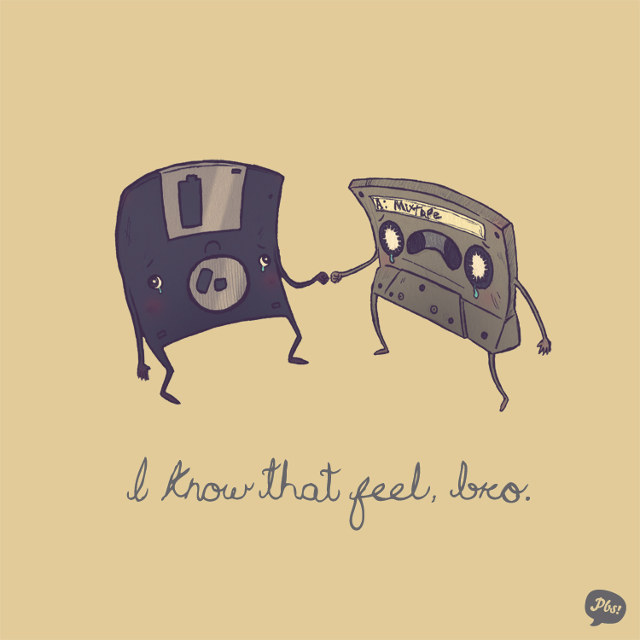

Slide 12
STUDENT EDITOR: MEDHANSH RAJDEO
MEMBERS: KIRTAM GANDHI
PRATHAM DOSHI
JANHAVI SHUKLA
VIDHUSHI KEDIA

